Slide 1
Battle of Neighborhood
-Sushil Mahato

Slide 2
Problem Background
The City of New York, is the most populous city in the United States. It is diverse and is the financial capital of USA. It is multicultural. It provides lot of business opportunities and business friendly environment. It has attracted many different players into the market. It is a global hub of business and commerce. The city is a major center for banking and finance, retailing, world trade, transportation, tourism and many more.
So, the market is highly competitive. As it is highly developed city so cost of doing business is also one of the highest. So before starting of a new business needs to be analysed carefully.

Slide 3
Problem Discription
A restaurant is a business which prepares and serves food and drink to customers in return for money, either paid before the meal, after the meal, or with an open account. The City of New York is famous for its excellent cuisine. It's food culture includes an array of international cuisines influenced by the city's immigrant history.
Some of famous foods of New York is - bagels, cheesecake, hot dogs, knishes, and delicatessens New York-style pizza and Italian cuisine pastrami and corned beef trattorias, diners, and coffeehouses are ubiquitous throughout the city falafel and kebabs examples of modern New York street food

Slide 4
Problem Discription
New York Population New York City Demographics Are there any Farmers Markets, Wholesale markets etc. nearby so that the ingredients can be purchased fresh to maintain quality and cost Are there any venues like Gyms, Entertainment zones, Parks etc. nearby where floating population is high etc. Who are the competitors in that location? Cuisine served / Menu of the competitors Segmentation of the Borough Untapped markets Saturated markets etc. The list can go on...
First move is very important, thereby choice of location is very important.

Slide 5
Success Criteria
The success criteria of the project will be measured by the good recommendation of neighborhood of New york city to open the Restaurant

Slide 6
Data that are needed
In this section I am going to discuss about the data we are going to use. For this project I am going to analyse the New York city.

Slide 7
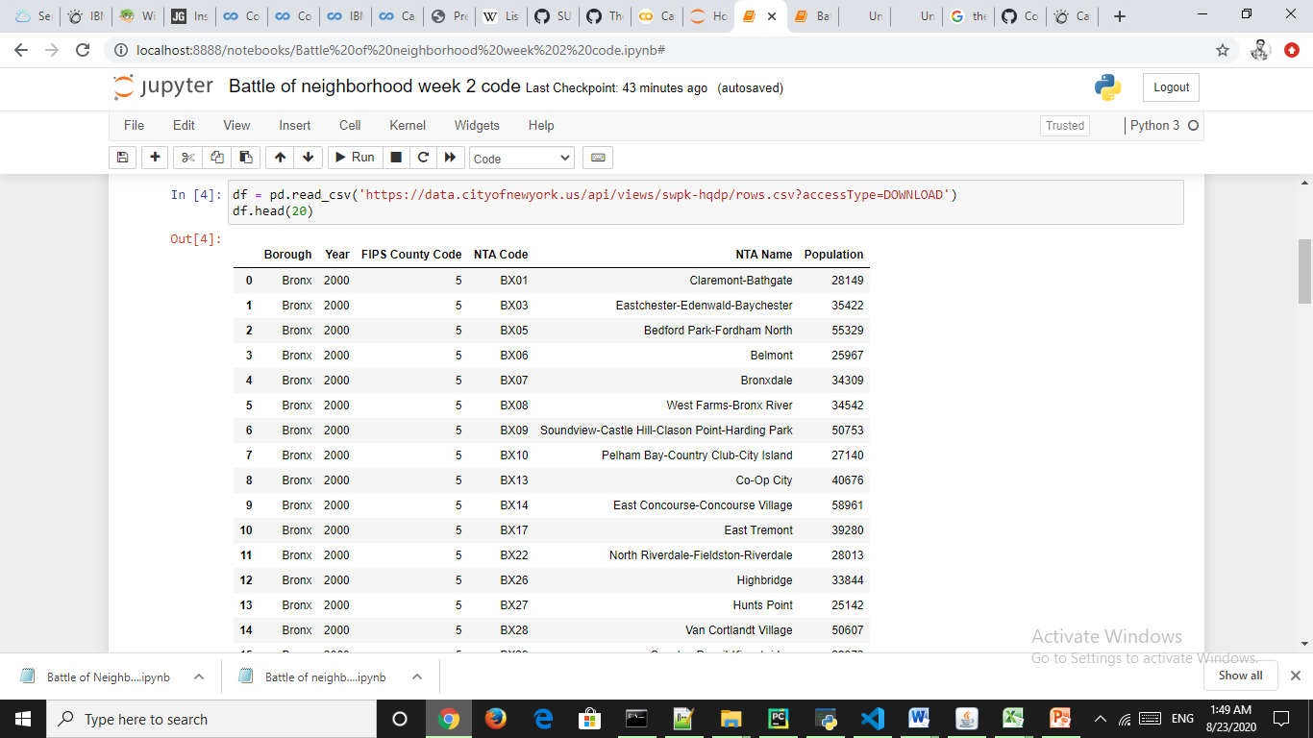
New York neighborhood city
with population

Slide 8
Data
https://en.wikipedia.org/wiki/New_York_City
https://en.wikipedia.org/wiki/Economy_of_New_York_City
https://en.wikipedia.org/wiki/Portal:New_York_City
https://en.wikipedia.org/wiki/Cuisine_of_New_York_City
https://en.wikipedia.org/wiki/List_of_Michelin_starred_restaurants_in_New_York_City

Slide 9
Methodology
To find the prefect city for restaurant opening, need to analyze the data.
And to analyze we need more number of data.

Slide 10
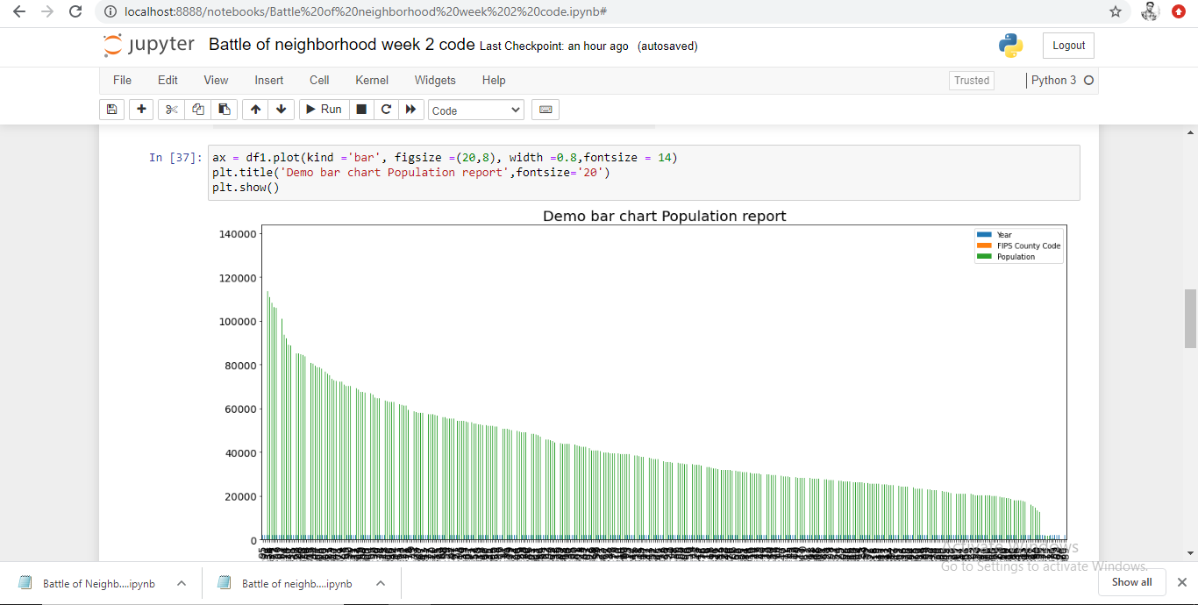
Bar chart of data
With population

Slide 11
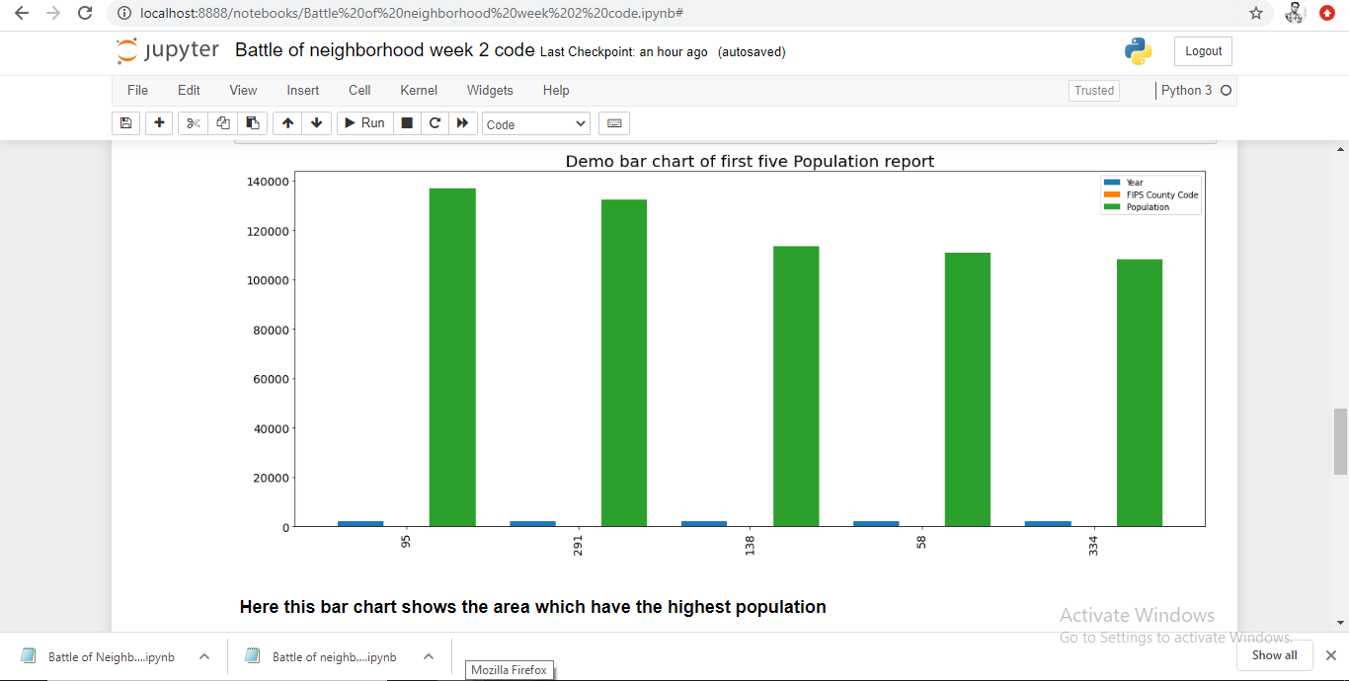
Bar chart of top 5 data
.

Slide 12
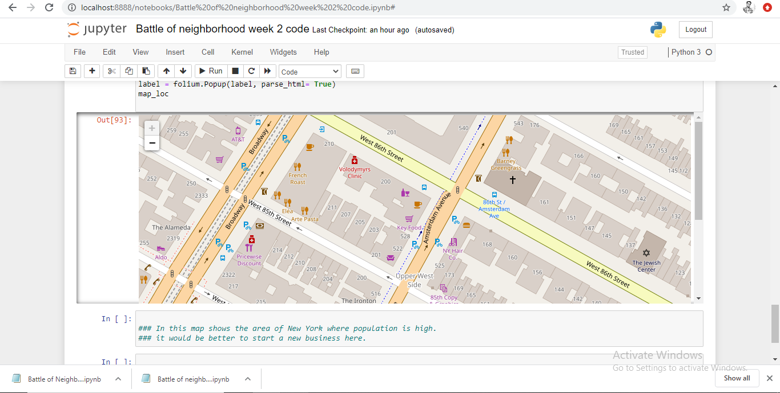
Map of New York city
Where population is high

Slide 13
Conclusion
So as shows in the diagrams the area with highest number of population, it would be better to start a business like restaurent in such areas.

